Slide 1
Unit 4: Planning
Vision reveals where the project is going and why it’s going there.
• Release Planning provides a roadmap for reaching your destination.
• The Planning Game combines the expertise of the whole team to create achievable plans.
• Risk Management allows the team to make and meet long-term commitments.
• Iteration Planning provides structure to the team’s daily activities.
• Slack allows the team to reliably deliver results every iteration.
• Stories form the line items in the team’s plan.
• Estimating enables the team to predict how long its work will take.

Slide 2
VISION:
“Our vision is to serve customers while maximizing stakeholder value and upholding the family values of our employees.”
Where Visions Come From
Sometimes the vision for a project strikes as a single, compelling idea. One person gets a bright idea, evangelizes it, and gets approval to pursue it. This person is a visionary.
More often, the vision isn’t so clear. There are multiple visionaries, each with their own unique idea of what the project should deliver.
Either way, the project needs a single vision. Someone must unify, communicate, and promote the vision to the team and to stakeholders. That someone is the product manager.

Slide 3
Identifying the Vision
If you only have one visionary, the best approach is to have that visionary act as product manager. This reduces the possibility of any telephone-game confusion. As long as the vision is both worthwhile and achievable, the visionary’s day-to-day involvement as product manager greatly improves the project’s chances of delivering an impressive product.
If the visionary isn’t available to participate fully, as is often the case, someone else must be the product manager.
Frequently, a project will have multiple visionaries. This is particularly common in custom software development. If this is the case on your project, you need to help the visionaries combine their ideas into a single, cohesive vision.
Rather than being a visionary himself, the product manager
facilitatesdiscussion between multiple visionaries. The best person for the job is one who understands the business well, already knows each of the visionaries, and has political savvy and good facilitation skills.

Slide 4
Documenting the Vision
After you’ve worked with visionaries to create a cohesive vision, document it in a vision statement. It’s best to do this collaboratively, as doing so will reveal areas of disagreement and confusion. Without a vision statement, it’s all too easy to gloss over disagreements and end up with an unsatisfactory product.
Once created, the vision statement will help you maintain and promote the vision. It will act as a vehicle for discussions about the vision and a touch point to remind stakeholders why the project is valuable.
The vision statement should be a living document: the product manager should review it on a regular basis and make improvements. However, as a fundamental statement of the project’s purpose, it may not change much.

Slide 5
How to Create a Vision Statement
The vision statement documents three things:
What the project should accomplish,
Why it is valuable, and
The project’s success criteria
The vision statement is a clear and simple way of describing why the project deserves to exist.
In the first section—what the project should accomplish—describe the problem or opportunity that the project will address, expressed as an end result. Be specific, but not prescriptive. Leave room for the team to work out the details.
Here is a real vision statement describing “Sasquatch,” a product developed by two entrepreneurs who started a new company:
Sasquatch helps teams collaborate over long distance. It enables the high-quality team dynamics that occur when teams gather around a table and use index cards to brainstorm, prioritize, and reflect.

Slide 6
Sasquatch’s focus is collaboration and simplicity. It is not a project management tool, a tracking tool, or a retrospectives tool. Instead, it is a free-form sandbox that can fulfil any of these purposes. Sasquatch assumes that participants are well-meaning and create their own rules. It does not incorporate mechanisms to enforce particular behaviours among participants.
Sasquatch exudes quality. Customers find it a joy to use, although they would be hard-pressed to say why. It is full of small touches that make the experience more enjoyable.
Collaboration, simplicity, and quality take precedence over breadth of features. Sasquatch development focuses on polishing existing features to a high gloss before adding new ones.

Slide 7
In the second section, describe why the project is valuable
Sasquatch is valuable to our customers because long-distance collaboration is so difficult without it. Even with desktop sharing tools, one person becomes the bottleneck for all discussion.
Teams used to the power of gathering around a table chafe at these restrictions. Sasquatch gives everyone an opportunity to participate. It makes long-distance collaboration effective and even enjoyable.
Sasquatch is valuable to us because it gives us an opportunity to create an entrepreneurial product. Sasquatch’s success will allow us to form our own product company and make a good living doing work that we love.

Slide 8
In the final section, describe the project’s success criteria:
how you will know that the project has succeeded and when you will decide. Choose concrete, clear, and unambiguous targets:
We will deploy Sasquatch in multiple stages with increasing measures of success at each stage.
In the first stage, we will demonstrate a proof-of-concept at a major Agile event. We will be successful if we attract a positive response from agile experts.
In the second stage, we will make a Sasquatch beta available for free use. We will be successful if at least 10 teams use it on a regular basis for real-world projects within 6 months.
In the third stage, we will convert Sasquatch to a pay service. We will be successful if it grosses at least $1,000 in the first three months.
In the fourth stage, we will rely on Sasquatch for our income. We will be successful if it meets our minimum monthly income requirements within one year of accepting payment.

Slide 9
How to Release Frequently
Releasing frequently doesn’t mean setting aggressive deadlines. . In fact, aggressive deadlines extends schedules rather than reducing them. Minimum marketable features are an excellent tool for doing so. A minimum marketable feature, or MMF, is the smallest set of functionality that provides value to your market, whether that market is internal users (as with custom software) or external customers (as with commercial software).
MMFs provide value in many ways, such as competitive differentiation, revenue generation, and cost savings.
As you create your release plan, think in terms of stakeholder value. Sometimes it’s helpful to think of stories and how they make up a single MMF. Don’t forget the minimum part of minimum
marketable feature—try to make each feature as small as possible.
Once you have minimal features, group them into possible releases. This is a brainstorming exercise, not your final plan, so try a variety of groupings. Think of ways to minimize the number of features needed in each release.
The most difficult part of this exercise is figuring out how to make small releases.

Slide 10
An Example: Imagine you’re the product manager for a team that’s creating a new word processor. The market for word processors is quite mature, so it might seem impossible to create a small first release. There’s so much to do just to match the competition, let alone to provide something new and compelling. You need basic formatting, spellchecking, grammar checking, tables, images, printing... the list goes on forever.
Release those features first—they probably have the most value.
Suppose that the competitive differentiation for your word processor is its powerful collaboration capabilities and web-based hosting. The first release might have four features: basic formatting, printing, web-based hosting, and collaboration. You could post this first release as a technical preview to start generating buzz. Later releases could improve on the base features and justify charging a fee: tables, images, and lists in one release, spellchecking and grammar checking in another, and so on.
If this seems foolish, consider Writely, the online word processing application. It doesn’t have the breadth of features that Microsoft Word does, and it probably won’t for many years. Instead, it focuses on what sets it apart: collaboration, remote document editing, secure online storage, and ease of use.

Slide 11
How to Create a Release Plan
There are two basic types of plans: scopeboxedplans and timeboxedplans. A scopeboxed plan defines the features the team will build in advance, but the release date is uncertain. A timeboxed plan defines the release date in advance, but the specific features that release will include are uncertain.
Timeboxed plans are almost always better. They constrain the amount of work you can do and force people to make difficult but important prioritization decisions. This requires the team to identify cheaper, more valuable alternatives to some requests. Without a timebox, your plan will include more low-value features. To create your timeboxed plan, first choose your release dates. I like to schedule releases at regular intervals, such as once per month and no more than three months apart.
Now flesh out your plan by using your project vision to guide you in
brainstorming minimum marketable features. Decompose these into specific
stories, and work with the programmers to get estimates. Using the estimates as a guide, prioritize the stories so that the highest-value, lowest-cost stories are done first.
The end result will be a single list of prioritized stories. Using your velocity,
risk factors, and story estimates, you can predict how many stories each release will include. With that information as a guide, discuss options for reducing costs and splitting stories so that each release provides a lot of value.
This final list of stories is your release plan. Post it prominently (I use a magnetic whiteboard—see Figure 8-4) and refer to it during iteration planning. Every week, consider what you’ve learned from stakeholders and discuss how you can use that information to improve your plan.

Slide 12
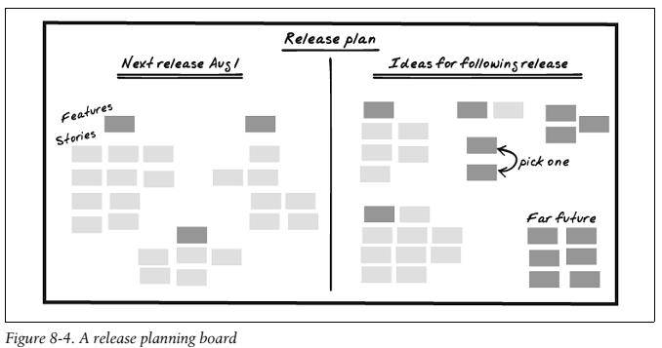

Slide 13
Planning at the Last Responsible Moment
To reduce waste, plan at the last responsible moment. The last responsible moment is the last moment at which you can responsibly make a decision Your planning horizon
determines how far you look into the future. Many projects try to determine every requirement for the project up front, thus using a planning horizon that extends to the end of the project.
To plan at the last responsible moment, use a tiered set of planning horizons. Use long planning horizons for general plans and short planning horizons for specific, detailed plans, as shown in Figure 8-5.
Your planning horizons depend on your situation and comfort level. The more commitments you need to make to stakeholders, the longer your detailed planning horizons should be. The more uncertain your situation is, or the more likely you are to learn new things that will change your plan, the shorter your planning horizons should be. If you aren’t sure which planning horizons to use, ask your mentor for guidance. Here are some good starting points:
• Define the visionfor the entire project.
• Define the release datefor the next two releases.
• Define the minimum marketable featuresfor the current release, and
start to place features that won’t fit in this release into the next release.
• Define all the storiesfor the current feature and most of the current
release. Place stories that don’t fit into the next release.
• Estimate and prioritizestories for the current iteration and the following three iterations.
• Determine detailed requirements and customer testsfor the stories in the current iteration.

Slide 14
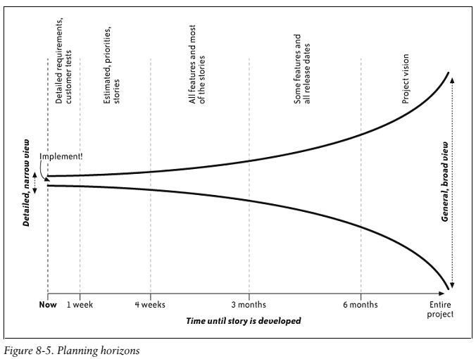

Slide 15
Risk-management :
Team members get sick and take vacations; hard drives crash, and although the backups worked, the restore doesn’t; stakeholders suddenly realize that the software you’ve been showing them for the last two months needs some major tweaks before it’s ready to use.
Despite these uncertainties, your stakeholders need schedule commitments that they can rely upon. Risk management allows you to make and meet these commitments.
A Generic Risk-Management Plan
Every project faces a set of common risks: turnover, new requirements, work disruption, and so forth. These risks act as a multiplier on your estimates, doubling or tripling the amount of time it takes to finish your work.
Provided some generic risk multipliers These multipliers show your chances of meeting
various schedules. For example, in a “Risky” approach, you have a 10 percent chance of
finishing according to your estimated schedule. Doubling your estimates gives you a 50 percent chance of on-time completion, and to be virtually certain of meeting your schedule, you have to quadruple your estimates.

Slide 16
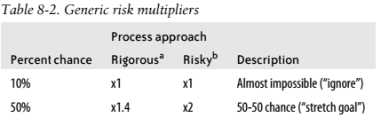
If you use the XP practices—in particular, if you’re strict about being “done done” every iteration, your velocity is stable, and you fix all your bugs each iteration—then your risk is lowered. Use the risk multiplier in the “Rigorous” column. On the other hand, if you’re notstrict about being “done done” every iteration, if your velocity is unstable, or if you postpone bugs and other work for future iterations, then use the risk multiplier in the “Risky” column.
Project-Specific Risks:
The generic risk multipliers include the normal risks of a flawed release plan, ordinary requirements growth, and employee turnover. In addition to these risks, you probably face some that are specific to your project. To manage these, create a risk census—that is, a list of the risks your project faces that focuses on your project’s unique risks. suggest starting work on your census by brainstorming catastrophes. Gather the whole team and hand out index cards. Remind team members that during this exercise, negative thinking is not only OK, it’s necessary. Ask them to consider ways in which the project could fail. Write several questions on the board:

Slide 17
1. What about the project keeps you up at night?
2. Imagine it’s a year after the project’s disastrous failure and you’re being interviewed about
what went wrong. What happened?
3. Imagine your best dreams for the project, then write down the opposite.
4. How could the project fail without anyone being at fault?
5. How could the project fail if it were the stakeholders’ faults? The customers’ faults?
Testers? Programmers? Management? Your fault? Etc.
6. How could the project succeed but leave one specific stakeholder unsatisfied or angry?
Write your answers on the cards, then read them aloud to inspire further thoughts. Some people may be more comfortable speaking out if a neutral facilitator reads the cards anonymously.
Once you have your list of catastrophes, brainstorm scenarios that could lead to those catastrophes. From those scenarios, imagine possible root causes. These root causes are your risks: the causes of scenarios that will lead to catastrophic results.

Slide 18
For the risks you decide to handle, determine transition indicators, mitigation and contingency activities, and your risk exposure:
• Transition indicators tell you when the risk will come true. It’s human nature to downplay upcoming risks, so choose indicators that are objective rather than subjective. For example, if your risk is “unexpected popularity causes extended downtime,” then your transition indicator might be “server utilization trend shows upcoming utilization over 80 present.”
• Mitigation activities reduce the impact of the risk. Mitigation happens in advance, regardless of whether the risk comes to pass. Create stories for them and add them to your release plan. To continue the example, possible stories include “support horizontal scalability” and “prepare load balancer.”
• Contingency activities also reduce the impact of the risk, but they are only necessary if the risk occurs. They often depend on mitigation activities that you perform in advance. For example, “purchase more bandwidth from ISP,” “install load balancer,” and “purchase and prepare additional frontend servers.”
• Risk exposure reflects how much time or money you should set aside to contain the risk. To calculate this, first estimate the numerical probability of the risk and then multiply that by the impact. When considering your impact, remember that you will have already paid for mitigation activities, but contingency activities are part of the impact. For example, you might believe that downtime due to popularity is 35 present likely, and the impact is three days of additional programmer time and $20,000 for bandwidth, colocation fees, and new equipment. Your total risk exposure is $7,000 and one day.

Slide 19
For the risks you decide to handle, determine transition indicators, mitigation and contingency activities, and your risk exposure:
• Transition indicators tell you when the risk will come true. It’s human nature to downplay upcoming risks, so choose indicators that are objective rather than subjective. For example, if your risk is “unexpected popularity causes extended downtime,” then your transition indicator might be “server utilization trend shows upcoming utilization over 80 present.”
• Mitigation activities reduce the impact of the risk. Mitigation happens in advance, regardless of whether the risk comes to pass. Create stories for them and add them to your release plan. To continue the example, possible stories include “support horizontal scalability” and “prepare load balancer.”
• Contingency activities also reduce the impact of the risk, but they are only necessary if the risk occurs. They often depend on mitigation activities that you perform in advance. For example, “purchase more bandwidth from ISP,” “install load balancer,” and “purchase and prepare additional frontend servers.”
• Risk exposure reflects how much time or money you should set aside to contain the risk. To calculate this, first estimate the numerical probability of the risk and then multiply that by the impact. When considering your impact, remember that you will have already paid for mitigation activities, but contingency activities are part of the impact. For example, you might believe that downtime due to popularity is 35 present likely, and the impact is three days of additional programmer time and $20,000 for bandwidth, colocation fees, and new equipment. Your total risk exposure is $7,000 and one day.

Slide 20
Stories
We plan our work in small, customer-centric pieces. Stories may be the most misunderstood entity in all of XP. They’re not requirements. They’re not use cases. They’re not even narratives. They’re much simpler than that.
Stories are for planning. They’re simple one- or two-line descriptions of work the team should produce. Alistair Cockburn calls them “promissory notes for future conversation.”
Everything that stakeholders want the team to produce should have a story, for example:
• “Warehouse inventory report”
• “Full-screen demo option for job fair”
• “TPS report for upcoming investor dog-and-pony show”
• “Customizable corporate branding on user login screen”
This isn’t enough detail for the team to implement and release working software, nor is that the intent of stories. A story is a placeholder for a detailed discussion about requirements. Customers are responsible for having the requirements details available when the rest of the team needs them.
Although stories are short, they still have two important characteristics:
1. Stories represent customer valueand are written in the customers’ terminology. (The best
stories are actually written by customers.) They describe an end-result that the customer
values, not implementation details.
2. Stories have clear completion criteria. Customers can describe an objective test that would
allow programmers to tell when they’ve successfully implemented the story.

Slide 21
The following examples are notstories:
• “Automate integration build” does not represent customer value.
• “Deploy to staging server outside the firewall” describes implementation details rather
than an end-result, and it doesn’t use customer terminology. “Provide demo that customer
review board can use” would be better.
• “Improve performance” has no clear completion criteria. Similarly, “Make it fast enough
for my boss to be happy” lacks objective completion criteria. “Searches complete within
one second” is better.
Story Cards
Write stories on index cards.
During release planning, customers and stakeholders gather around a big table to select stories for the next release. It’s a difficult process of balancing competing desires. Index cards help prevent these disputes by visually showing priorities, making the scope of the work more clear, and directing conflicts toward the plan rather than toward personalities.
Story cards also form an essential part of an informative workspace. After the
planning meeting, move the cards to the release planning board—a big, sixfoot whiteboard, placed prominently in the team’s open workspace. You can post hundreds of cards and still see them all clearly. For each iteration, place the story cards to finish during the iteration on the
iteration planning board.
Index cards also help you be responsive to stakeholders. When you talk with a stakeholder and
she has a suggestion, invite her to write it down on a blank index card. Afterward, take the stakeholder and her card to the product manager. They can walk over to the release planning board and discuss the story’s place in the overall vision. Again, physical cards focus the discussion on relative priorities rather than on contentious “approved/disapproved” decisions.

Slide 22
If the product manager and stakeholder decide to add the story to the release plan, they can take it to the programmers right away. A brief discussion allows the programmers to estimate the story. Developers write their estimate—and possibly a few notes—on the card, and then the stakeholder and product manager place the card into the release plan.
Physical index cards enable these ways of working in a very easy and natural way that’s surprisingly difficult to replicate with computerized tools.

